Slide 1
Secure Data Hiding in Image Using Steganography
CAPSTONE PROJECT
Presented By: K LASYA RAO
Student Name : K LASYA RAO
College Name & Department : INSTITUTE OF AERONAUTICAL ENGINEERING,
COMPUTER SCIENCE AND ENGINEERING

Slide 2
OUTLINE
Problem Statement
Technology used
Wow factor
End users
Result
Conclusion
Git-hub Link
Future scope

Slide 3
Problem Statement
With the rise of digital communication, sensitive data is often at risk of interception by hackers, surveillance programs, or unauthorized entities. Traditional encryption methods, while effective, can attract unwanted attention, making them targets for cryptanalysis. This project addresses the need for a secure yet hidden way to transmit messages by embedding secret text within images using steganography. By disguising confidential information within media files, this approach ensures that private communication remains undetectable while maintaining the integrity of the cover image.

Slide 4
Technology used
Programming Language: Python for its versatility and strong support for image processing.
Libraries:
OpenCV: Used for reading, modifying, and saving images in various formats.
Tkinter: Provides an interactive GUI for a user-friendly experience.
PIL (Pillow): Helps in image resizing and manipulation for proper display.
NumPy: Used for efficient pixel manipulation in the image matrix.
Concepts: Least Significant Bit (LSB) Steganography, Image Processing, GUI Development, and Cryptographic Techniques.

Slide 5
Wow factors
Seamless Message Hiding: Encrypts messages inside images without altering their visible appearance, ensuring covert communication.
Password-Protected Encryption: Users must enter a password to retrieve the hidden message, adding an extra layer of security.
Cross-Format Compatibility: Supports widely used image formats like PNG, JPG, and JPEG.
User-Friendly GUI: Simplifies the encryption and decryption process, making it accessible to both technical and non-technical users.

Slide 6
End users
Cybersecurity professionals for secure message transmission.
Journalists & Activists working in high-risk environments.
Military & Intelligence agencies for covert communication.
General users who want to send private messages securely

Slide 7
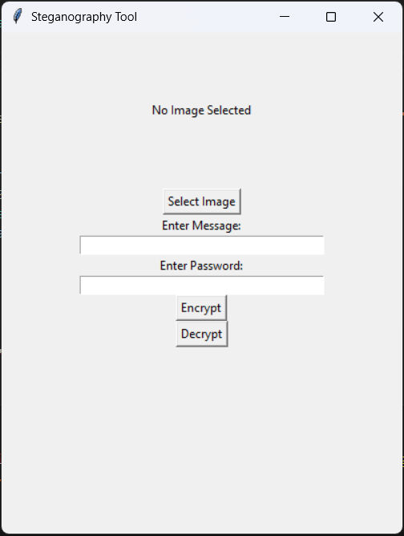
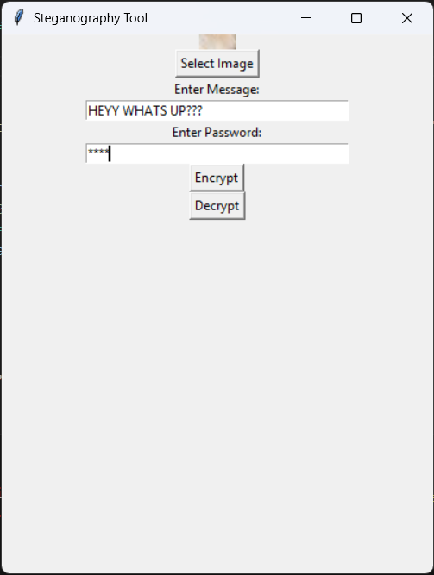
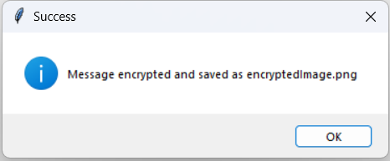
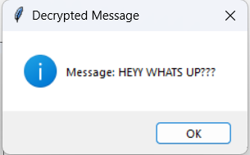
Results

Slide 8
Conclusion
Steganography offers an innovative way to secure digital communication by concealing messages within images.
This project successfully demonstrates a practical implementation of image-based encryption, ensuring privacy while keeping messages undetectable.
With an easy-to-use interface and robust security features, this tool can be beneficial for individuals and organizations seeking confidential communication solutions.
The project highlights the potential of steganography in enhancing digital privacy and sets the foundation for further advancements in covert messaging systems.

Slide 9
GitHub Link
GITHUB LINK:
https://github.com/Lasya1905/Steganography.git

Slide 10
Future scope
Advanced Encryption: Implementing AES or RSA encryption before embedding messages for enhanced security.
Multi-Layered Steganography: Embedding messages across different parts of an image to further obscure detection.
Support for Audio and Video Steganography: Expanding the technique to hide messages in sound or video files.
Stealth Mode: Making modifications even less detectable by using adaptive steganography techniques.
Mobile Application Development: Creating a cross-platform app for Android and iOS, making the tool more accessible.

Slide 11
THANK YOU

